Slide 1
Section 7.6
Graphs of the Sine and Cosine Functions
Copyright © 2012 Pearson Education, Inc. Publishing as Prentice Hall.

Slide 2

Copyright © 2012 Pearson Education, Inc. Publishing as Prentice Hall.

Slide 3
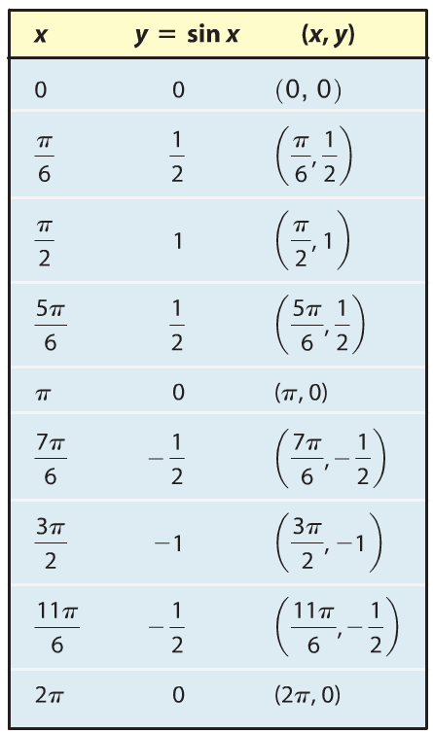
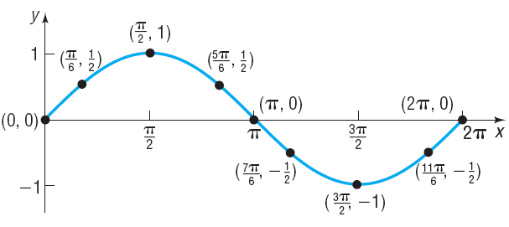

Copyright © 2012 Pearson Education, Inc. Publishing as Prentice Hall.

Slide 4
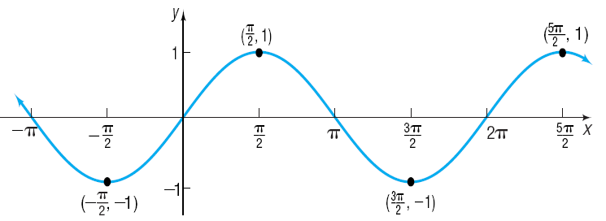

Copyright © 2012 Pearson Education, Inc. Publishing as Prentice Hall.

Slide 5
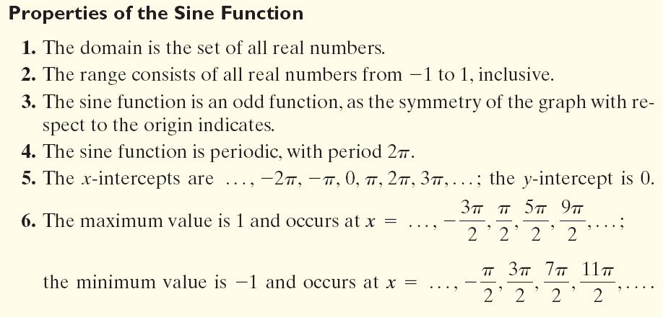
Copyright © 2012 Pearson Education, Inc. Publishing as Prentice Hall.

Slide 6

Copyright © 2012 Pearson Education, Inc. Publishing as Prentice Hall.

Slide 7


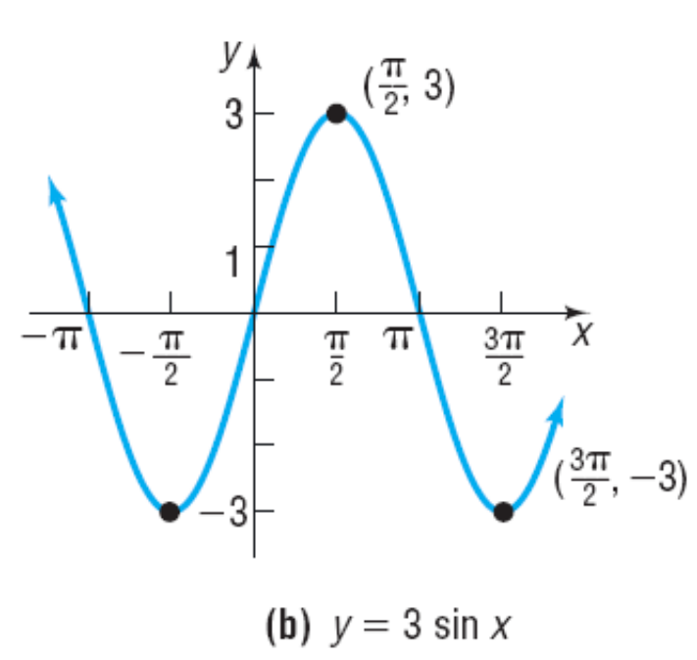
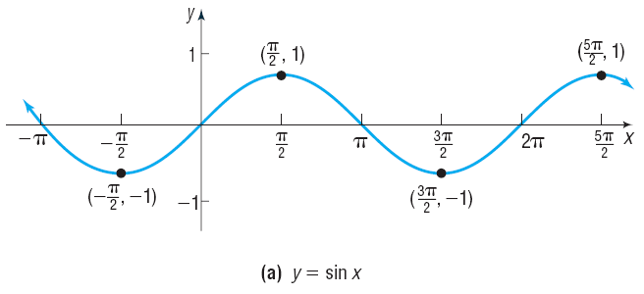
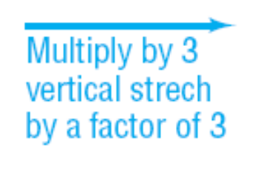
Copyright © 2012 Pearson Education, Inc. Publishing as Prentice Hall.

Slide 8
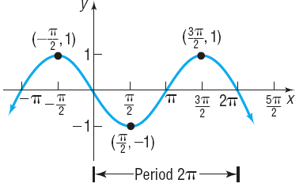
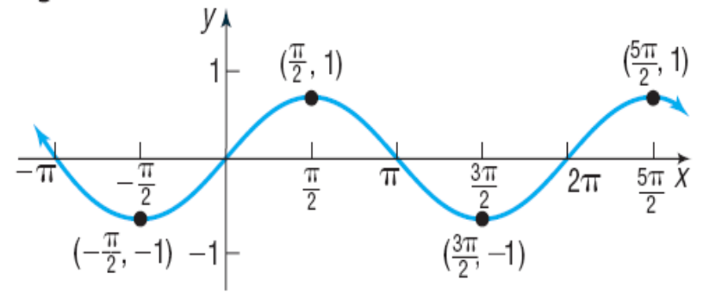
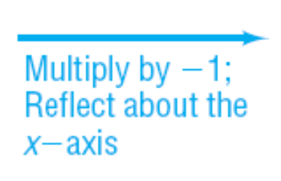
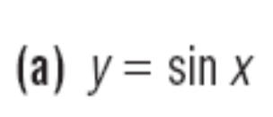

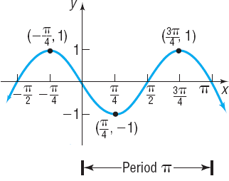



Slide 9
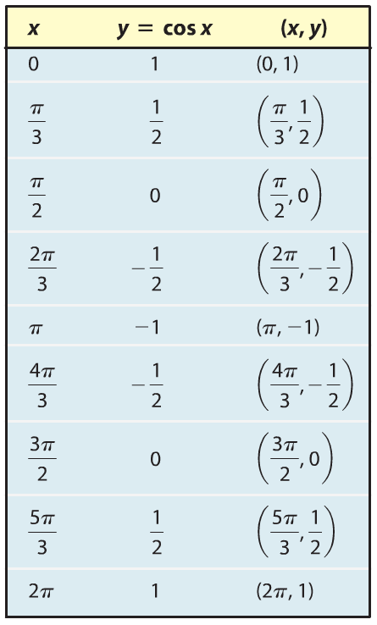
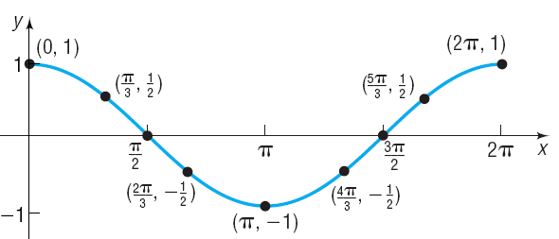

Copyright © 2012 Pearson Education, Inc. Publishing as Prentice Hall.

Slide 10
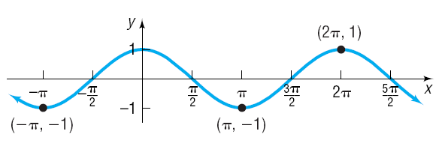

Copyright © 2012 Pearson Education, Inc. Publishing as Prentice Hall.

Slide 11
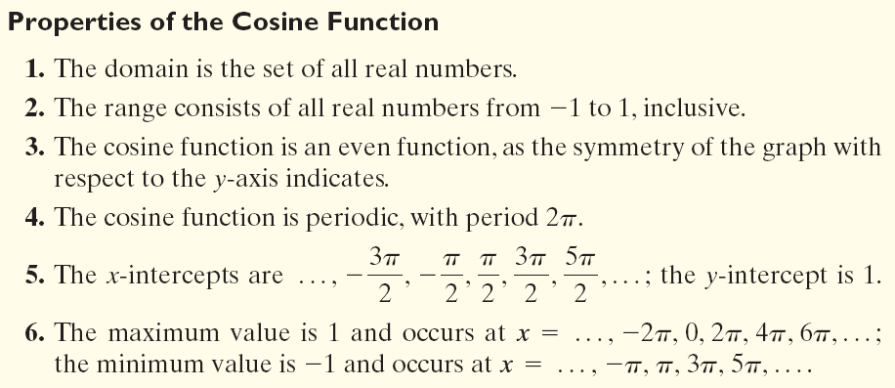
Copyright © 2012 Pearson Education, Inc. Publishing as Prentice Hall.

Slide 12

Copyright © 2012 Pearson Education, Inc. Publishing as Prentice Hall.

Slide 13
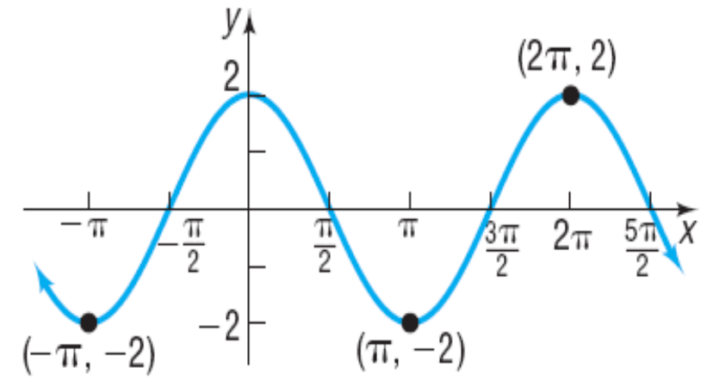
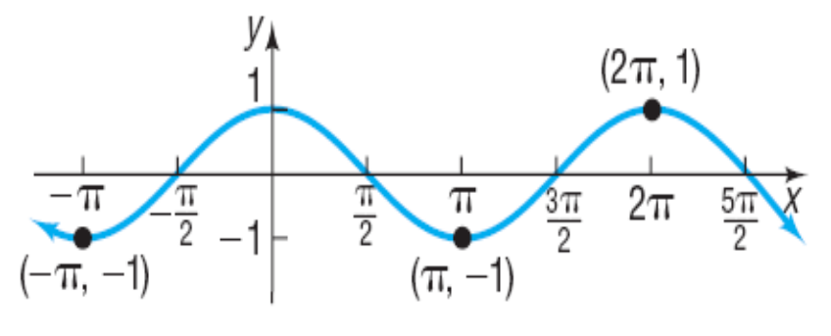
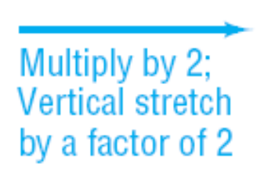
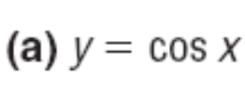

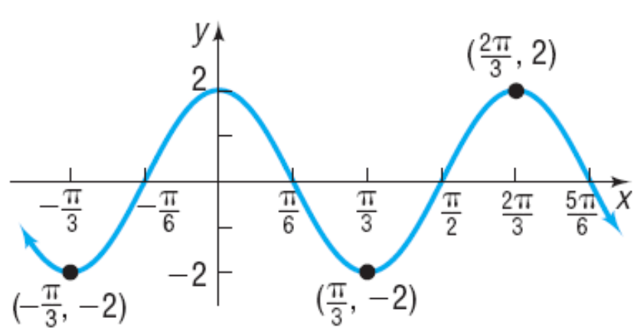
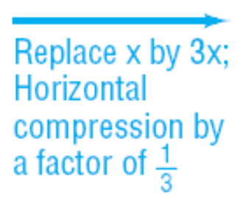

Copyright © 2012 Pearson Education, Inc. Publishing as Prentice Hall.

Slide 14

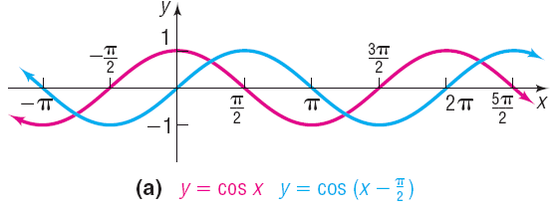
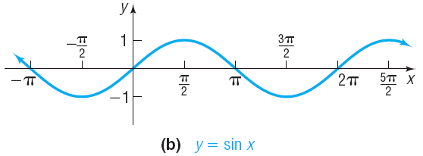
Copyright © 2012 Pearson Education, Inc. Publishing as Prentice Hall.

Slide 15

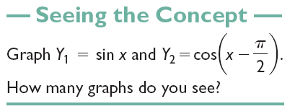


Copyright © 2012 Pearson Education, Inc. Publishing as Prentice Hall.

Slide 16
Copyright © 2012 Pearson Education, Inc. Publishing as Prentice Hall.

Slide 17
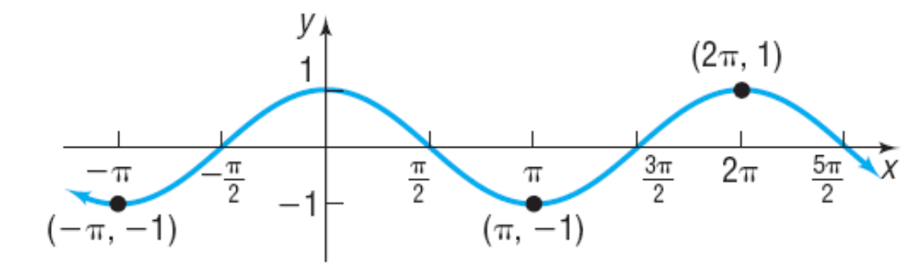
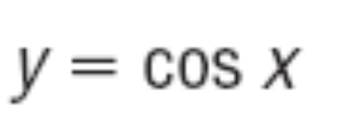
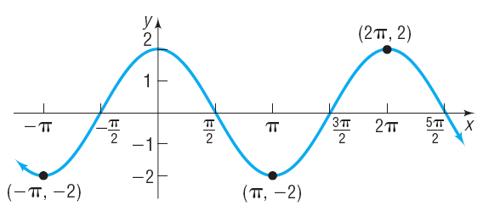
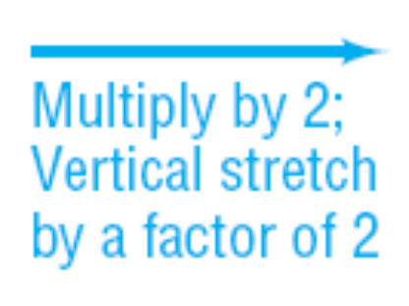

Copyright © 2012 Pearson Education, Inc. Publishing as Prentice Hall.

Slide 18
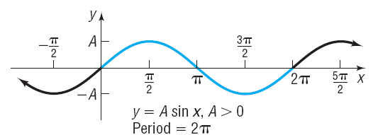
Amplitude
Copyright © 2012 Pearson Education, Inc. Publishing as Prentice Hall.

Slide 19
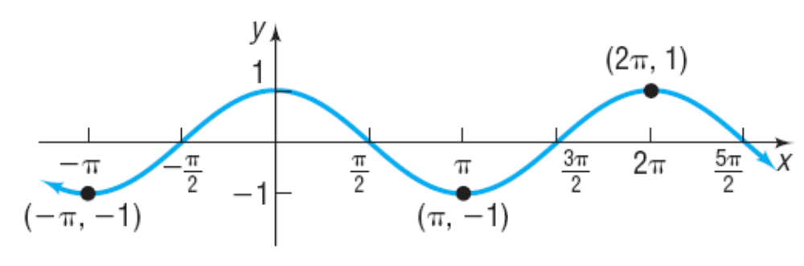

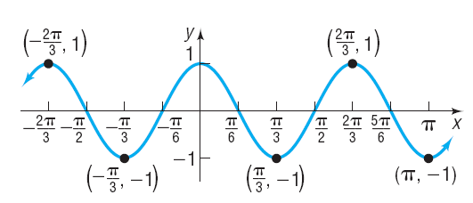
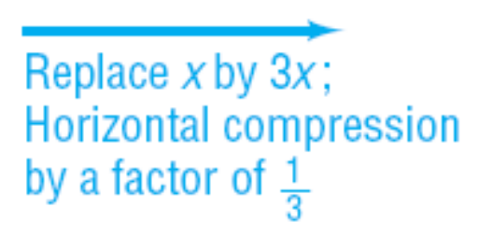

Copyright © 2012 Pearson Education, Inc. Publishing as Prentice Hall.

Slide 20
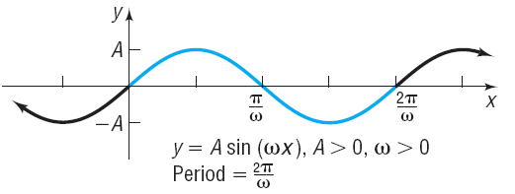

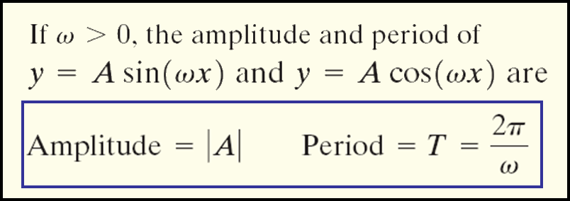
Copyright © 2012 Pearson Education, Inc. Publishing as Prentice Hall.

Slide 21
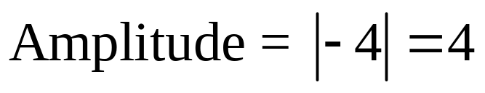
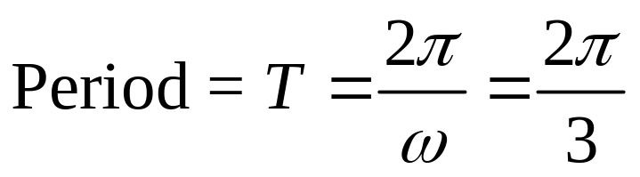
Determine the amplitude and period of y = – 4 cos (3x)
Copyright © 2012 Pearson Education, Inc. Publishing as Prentice Hall.

Slide 22
Copyright © 2012 Pearson Education, Inc. Publishing as Prentice Hall.

Slide 23
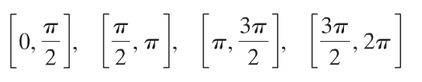
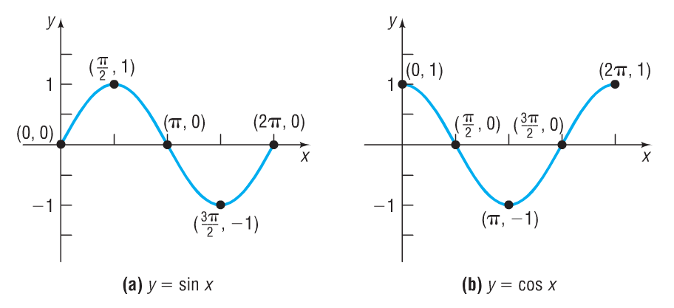


Copyright © 2012 Pearson Education, Inc. Publishing as Prentice Hall.

Slide 24
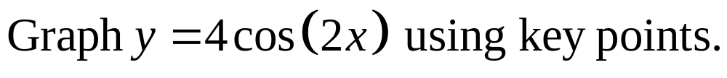

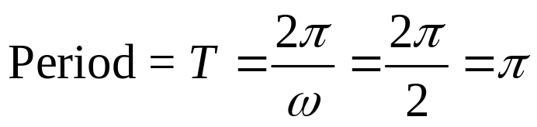
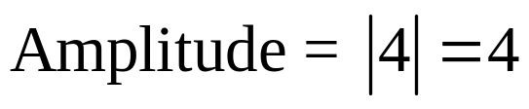
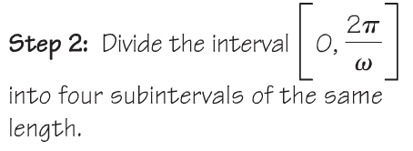
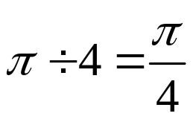
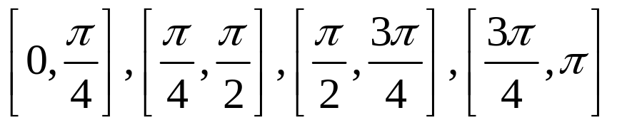
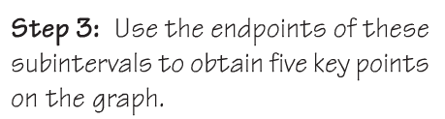
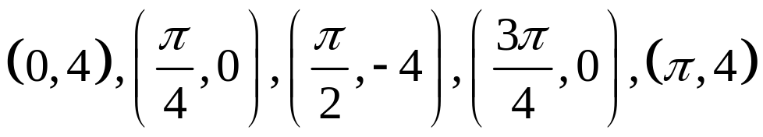
Copyright © 2012 Pearson Education, Inc. Publishing as Prentice Hall.

Slide 25
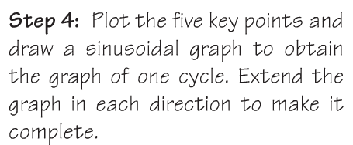
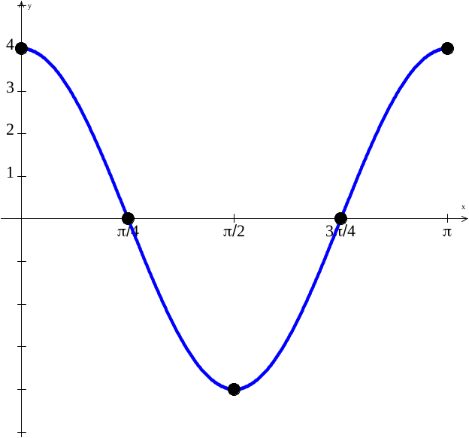
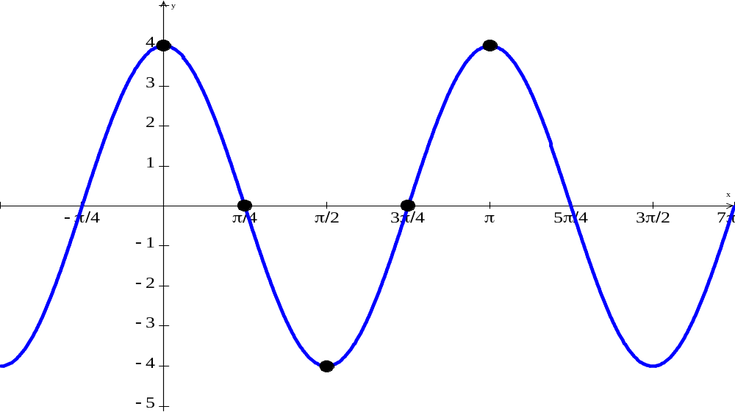
Copyright © 2012 Pearson Education, Inc. Publishing as Prentice Hall.

Slide 26

Copyright © 2012 Pearson Education, Inc. Publishing as Prentice Hall.

Slide 27







Copyright © 2012 Pearson Education, Inc. Publishing as Prentice Hall.

Slide 28







Copyright © 2012 Pearson Education, Inc. Publishing as Prentice Hall.

Slide 29
Copyright © 2012 Pearson Education, Inc. Publishing as Prentice Hall.

Slide 30





A = 3
Copyright © 2012 Pearson Education, Inc. Publishing as Prentice Hall.

Slide 31





Note that this is a reflection over the x-axis of the sine function so while the amplitude is 2, A = –2.
A = – 2
Copyright © 2012 Pearson Education, Inc. Publishing as Prentice Hall.

